Slide 1
EE 4130 Systems Engineering: Trade Studies
Prof Joel Harris
26 February 2018
CSULA – ECST Department

Slide 2
Why Perform a Trade Study
To gather and assess the possible design solutions for the new system that one is seeking to create
Determining whether to make or buy a needed asset/tool/software application
Further, to methodically evaluate the attributes and characteristics of each potential design, in light of the system level requirements
Reduce uncertainty and risk associated with system development
Finally, to arrive at a decision as to which potential design solution will provide a “balanced” approach that will result in a system that is both realizable and functional

Slide 3
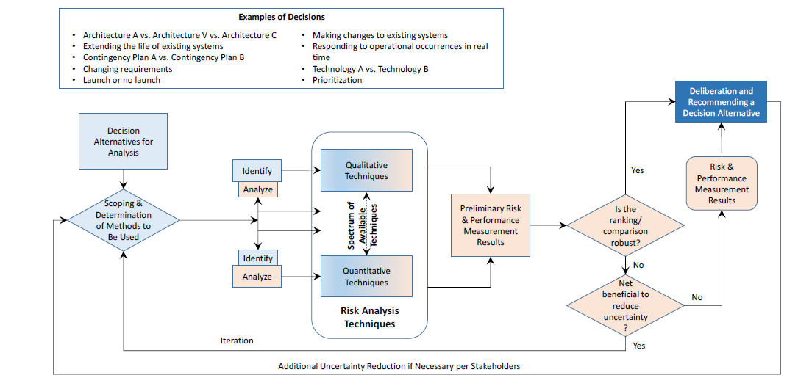
Decision Process Map
Source: NASA Systems Engineering Handbook – Rev 2

Slide 4
Examples of where trade studies can be applied
choosing how and where to allocate limited resources /budget within a project
Decisions regarding whether to proceed to the next checkpoint/gate in the system development process
At what times to conduct required system project reviews (SRR, PDR, CDR, PRR, etc.)
Selection of which risk management methodology to apply to significant project risks to system creation while considering costs, schedule, and technical performance of the emerging threat

Slide 5
Means to conduct a trade study
Qualitative approach
Typically the simplest and easiest to perform
Uses linguistic descriptors to compare alternatives/attributes
Drawback: possible subjective bias when making comparisons
Quantitative approach
Uses methodologies including pairwise comparisons, decision trees, or AHP
Advantage: less prone to analyst bias…

Slide 6
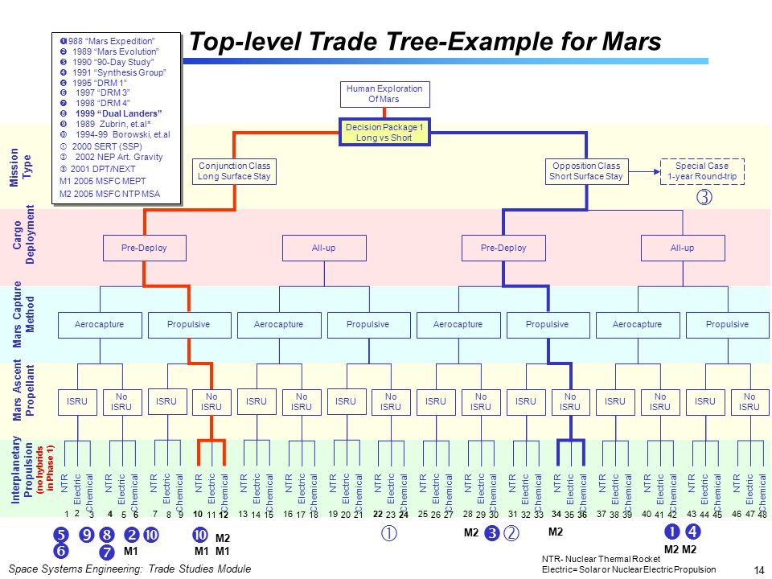
A “trade tree” example
Source: NASA Systems Engineering Handbook – Rev 2

Slide 7
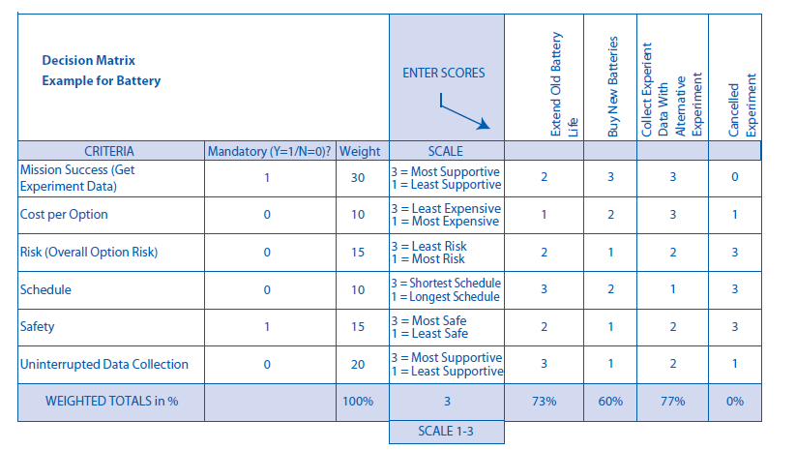
Trade Study/decision using the decision matrix method

Slide 8
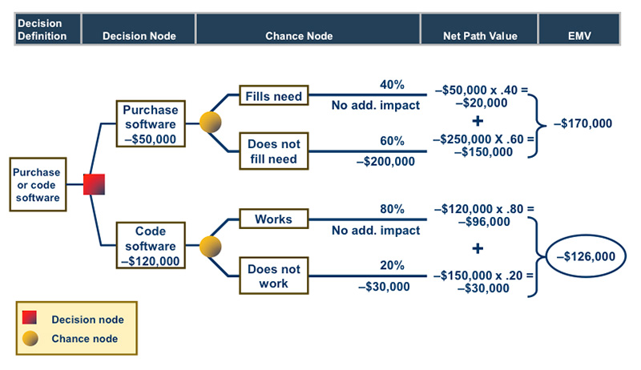
Another decision tree example

Slide 9
Another Trade Study quantitative tool/method
AHP – Analytic Hierarchy Process
Uses “pairwise comparisons” of attributes/characteristics under consideration (evaluation criteria and multiple alternatives)
Employs matrix/linear algebra techniques to arrive at the optimum choice to make when considering mCMA decisions
Was first developed by Thomas Saaty at University of Pittsburgh in the 1970s

Slide 10
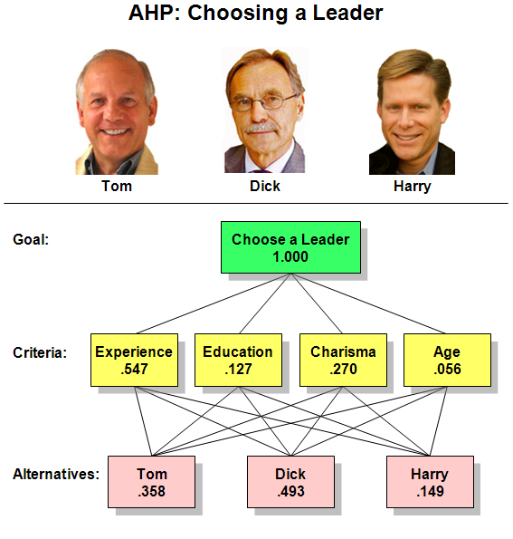
Rudimentary AHP example overview
Source: Wikipedia

Slide 11
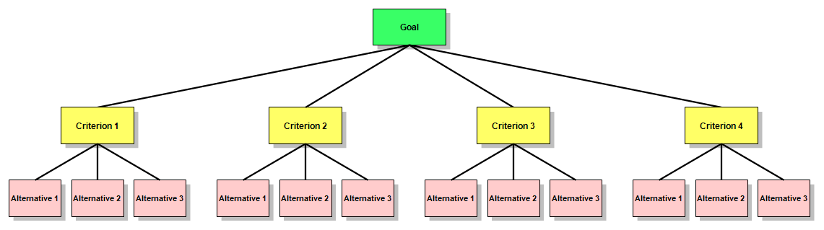
Elements of the AHP
Objective or goal that sits at the head of the hierarchy
Selection criteria upon which the analysis will be performed (each one has a weight/importance factor expressed as a % - note: all criteria add up to unity)
Alternatives from which to choose when making a final decision.
Source: Wikipedia

Slide 12
… more details to come on Wednesday’s class… --- stay tuned !!

